Slide 1


Slide 2
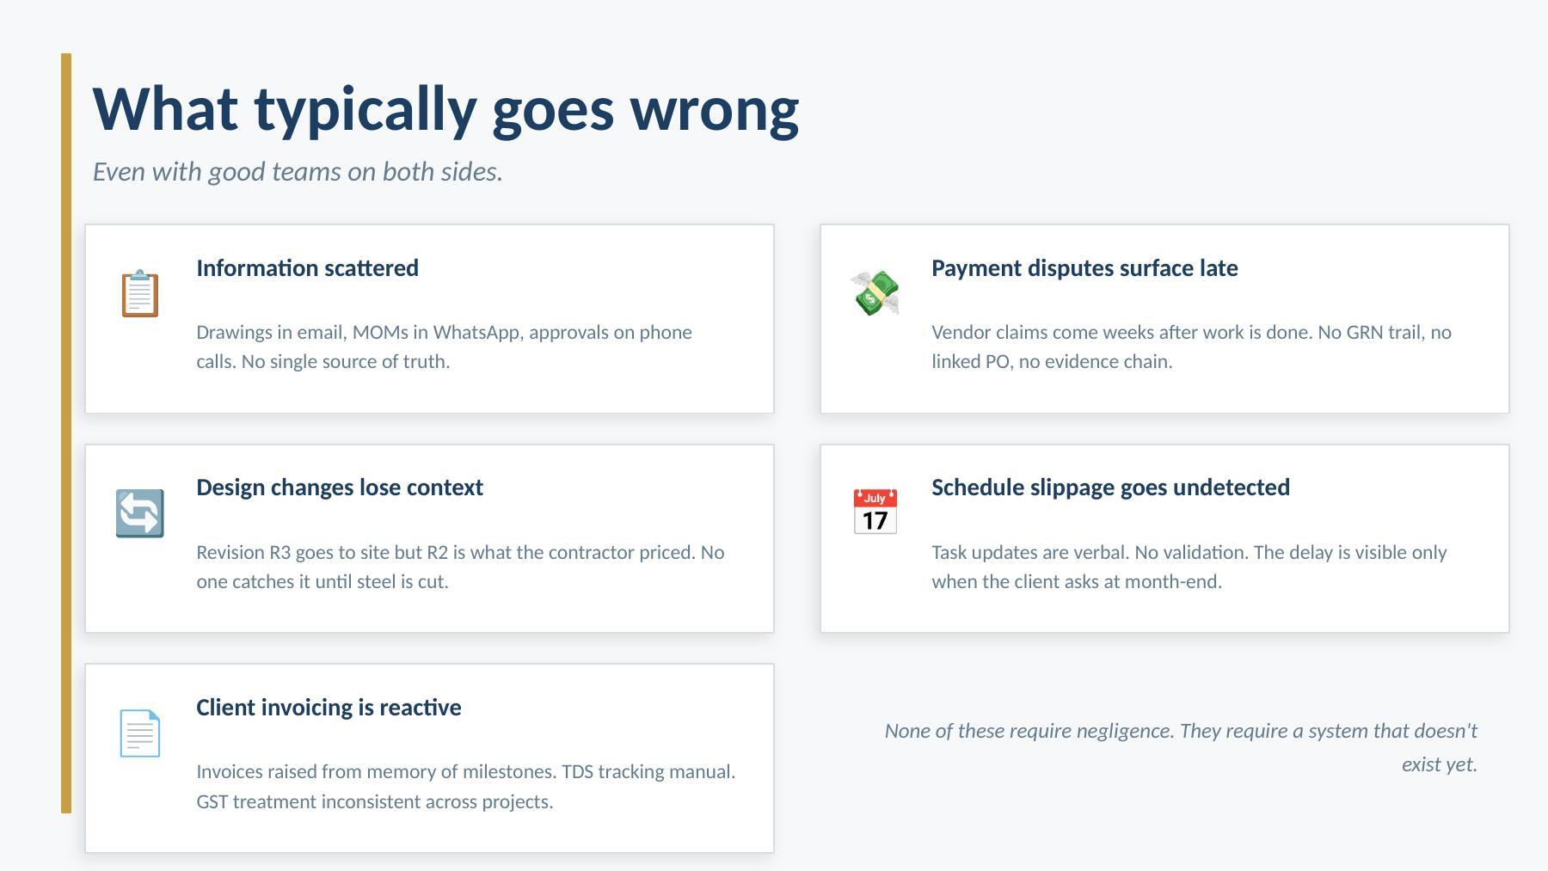

Slide 3
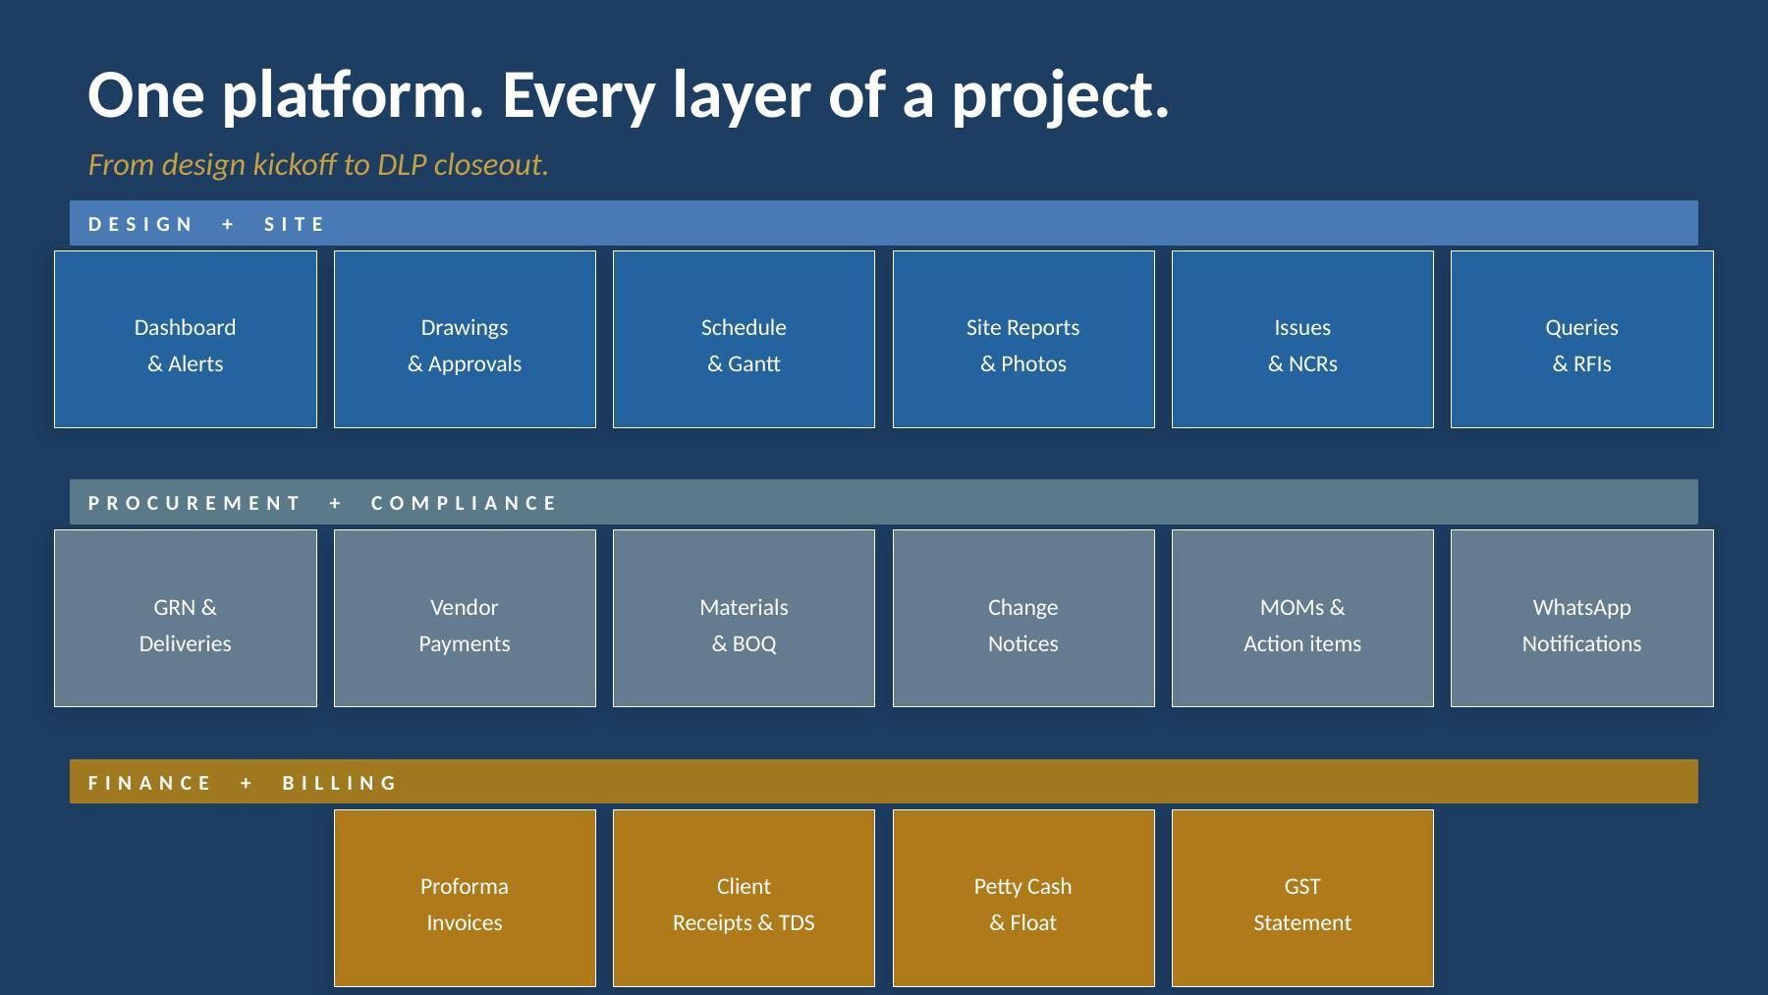

Slide 4
Dashboard — Action Centre
⬛ Action Centre
3
7
2
Every person sees only what they need to act on — filtered by role, project, and urgency.
Overdue
Pending
Alerts
REQUIRES ACTION
• Red items demand action today — overdue reports, unanswered drawing queries
Drawing queries — overdue
4 OPEN
4 unanswered 3+ days
• Amber items need attention this week — pending approvals, open flags
NCR — Site quality issue
OPEN
• Blue items are in motion — CN signatures being collected
GRN-024, Block A slab
• Each item deep-links directly to the affected record
Materials overdue
3 LATE
3 items past needed-by
• Separate dashboard for each role: site, design, finance, PMC
THIS WEEK
Approvals pending
PENDING
2 awaiting Principal
Weekly report approved
DONE
Wk 14 — WESCH Phase 01

Slide 5
Drawings — Two-level approval, no shortcuts
📐 Drawings — WESCH Phase 01
STRUCTURAL
Every drawing revision goes through the same gate before reaching site.
WESCH-S-001 R3
ISSUED
RCC Column Grid A-F
Upload
→
L1 Review
→
L2 Approve
→
Issued ✓
WESCH-S-002 R1
PENDING
Architect
Detailing / Svc head
Principal / Design head
Site can build
Awaiting: L2 approve
WESCH-S-003 R0
QUERY
• Reject path sends drawing back with comments — no revision silently dropped
Query open — Grid B offset
• Superseded revisions locked — site cannot act on outdated drawings
SERVICES
WESCH-M-001 R2
ISSUED
• Every approval records who, when, and from which IP
Plumbing Schematic
• Drawing queries raised against specific revision — linked, not lost in chat
WESCH-E-001 R1
ISSUED
LT Panel Layout
• Query response triggers WhatsApp notification to the raising team
WESCH-E-002 R0
PENDING
Pending L1 review

Slide 6
Schedule — Tasks validated, not just ticked
📅 Schedule — Week 14
68%
4d
Site manager reports progress. PMC head validates before it counts.
Overall
Float
THIS WEEK
• Schedule uploaded as Excel — task ID, name, trade, start/end, weight %
PCC Footing — Grid C
DONE
Civil · 100% · Validated ✓
• Site manager marks % complete with daily report — not unilateral
RCC Columns G+1
REVIEW
• PMC validates each task completion before it rolls into overall progress
Structural · 65% · Pending PMC
• Re-upload locks the old version — full revision history with date
MEP rough-in
LATE
Services · 40% · Behind 3d
• Daily reports include photo evidence, labour count, issues flagged
LOOK AHEAD
• AI anomaly detection flags suspicious entries (e.g. 100% in one day)
Steel fabrication
ON TRACK
Structural · Starts Mon
• Weekly health report auto-generated and reviewed before going to client

Slide 7
Procurement — Every rupee linked to delivery
💰 Payment Requests
₹12.4L
₹44.8L
No payment without a GRN. No GRN without a PO. Disputes become facts.
Pending
Paid MTD
AWAITING APPROVAL
• Vendor engaged with scope, contract value, and mobilisation date on record
Shri Tiles — Supply + Labour
PMC REVIEW
GRN-041 · ₹2,18,450
• GRN raised against delivery — quantity, quality flag, photo evidence
Ravi Electrical Contractors
PMC REVIEW
• NCR raised directly from a GRN if quality non-conforming — vendor notified
GRN-039 · ₹88,000
PRINCIPAL APPROVAL
• Payment request raised against GRN trail — not from memory
Aryan Steel — Reinforcement
PENDING
• Approval chain: PMC Head → Principal → finance
GRN-038 · ₹7,14,200
• ICICI bulk payment file generated, reviewed with expected total, then applied
RECENTLY PAID
Bharat Formwork Ltd
PAID
• UTR confirmation from bank updates each payment record automatically
UTR 123456789 · ₹3,42,000

Slide 8
MOMs — Agreed. Issued. Acknowledged.
📋 MOMs — WESCH Phase 01
RECENT
A MOM that was never seen by the client is not a MOM.
MOM-042 Site Coordination
ACKED
Issued 14 Apr · Client ✓
Draft
→
PMC Approves
→
Preview Checked
→
Sent to Client
→
Client Acknowledges
MOM-041 Design Review
ACKED
PMC
Issued 07 Apr · Client ✓
• PMC approves internally first — client never sees a draft by accident
MOM-043 Contractor Mtg
APPROVED
PMC approved · Not yet sent
• Preview step shows exact WhatsApp message before it is sent
ACTION ITEMS (open)
• Client acknowledges via WhatsApp reply — timestamp recorded
Contractor to resubmit shop dwgs
OPEN
Due: 20 Apr · Owner: Site team
• Action items extracted from MOM — tracked to closure separately
Engineer to confirm footing load
OPEN
• Up to 4 revisions before MOM is locked; each revision is versioned
Due: 18 Apr · Owner: Services
Rebar delivery rescheduled
DONE
Done 16 Apr

Slide 9
Finance — From milestone to receipt, fully tracked
🧾 Invoices — WESCH Phase 01
₹54.2L
₹38.4L
Billing tied to the fee schedule. Every rupee in and out has a paper trail.
Raised
Received
PROFORMA INVOICES
• Proforma invoices raised against pre-agreed fee-schedule milestones
PI/WESCH/2026/001
PAID
Stage 1 — Concept · ₹11,24,550
• Client master must be complete (GSTIN, Tally ledger) before first PI — enforced
PI/WESCH/2026/002
PAID
• GST treatment (regular / SEZ / unregistered) set per client, not per project
Stage 2 — Schematics · ₹9,38,000
• Client receipt records UTR, date, amount, and TDS deducted
PI/WESCH/2026/003
SENT
Stage 3 — DD · ₹15,74,250
• TDS auto-computed and logged — reconcilable against Form 26AS
PI/WESCH/2026/004
PENDING
Stage 4 — WD · Not yet raised
• Petty cash float tracked with running balance — expense categories enforced
• Tally-XML export available for each client receipt

Slide 10
Built-in guardrails.
Not every system needs a human to prevent every mistake. Some should be structurally impossible.
🔐 Preview before every external send
📒 Audit log — every action, every user
MOMs, NCR notices, vendor payments — a confirmation step with expected total shows what will happen before it does.
Who approved, when, from which IP. Anomaly acknowledgements, MOM unlocks, client receipt recordings — all permanently logged.
🔒 Role-permission governance
🧾 Client master guard on PI
318 backend routes across 15 roles. Permission matrix defines who can do what — not buried in code. Pre-delivery scanner validates gates on every build.
No PI can be raised until GSTIN and Tally ledger are set. Wrong GSTIN on a tax invoice is not a recoverable error.
⚙️ Optimistic locking on critical records
🔄 Two-step all irreversible actions
Two people cannot simultaneously approve the same payment or MOM. The second save detects the conflict and rejects it.
ICICI payment file, vendor NCR notice, MOM to client — all split into preview → confirm with typed code. No single-click disasters.

Slide 11
WhatsApp — where your team already is
💬 nu PMC Alerts
✅ Payment confirmed
No app to install. No separate login for the field team.
Vendor: Shri Tiles · ₹2,18,450
UTR: 826100012345 · WESCH Phase 01
• Payment confirmations sent to vendors the moment UTR is applied
📋 MOM-043 sent to client
S.P. Mandali — WeSchool
• Site manager gets task-rejection notice with reason — not a vague call
Please reply YES to acknowledge.
• Client receives MOM preview; their reply is captured as acknowledgement
⚠️ Drawing query open 3+ days
WESCH-S-003 R0 · Grid B offset
• NCR notice to vendor links the GRN reference and required rectification
No response from design
• Drawing issued to site — notification with revision number and category
🆕 New client stub created
• Finance admin gets a task when a new stub client needs master completion
Acme Industries Pvt Ltd
Complete master before first PI
• All notifications go through a delivery log — sent, delivered, read, failed

Slide 12
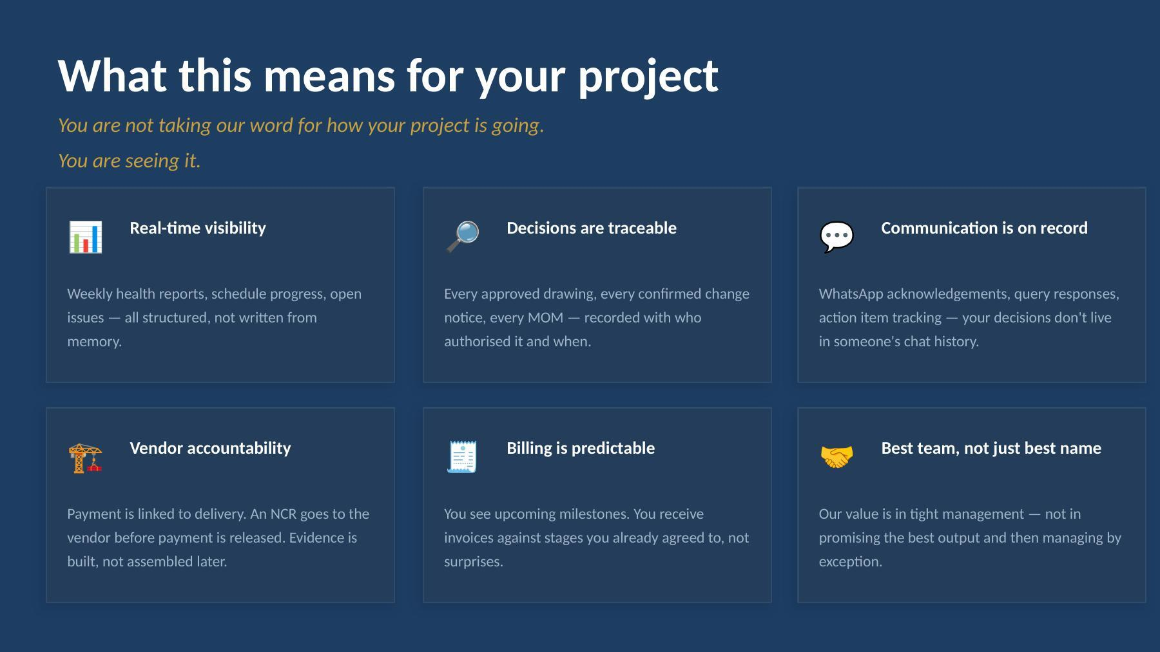

Slide 13
By the numbers
These are engineering facts, not marketing claims.
318
124
15
Backend API routes
Automated tests
User roles
scanner-validated on every build
integration, not just unit
from trainee to principal
5
16+
0
External-send guardrails
Tracked modules
Single-click disasters
preview → confirm → audit
design to DLP closeout
all irreversible actions two-step

Slide 14


